Slide 1

Determine Locations for New Yoga Center in Bangalore
By Swapneel Prasanth Mishra

Slide 2
Bangalore is the New Hub of Business
Thanks to IT industry Bangalore has Grown exponentially in past decade.
Rise in population has meant high demand for services
Its now new hub of Start Up businesses
Tech Savvy people looking for affordable fitness centres.
Fitness focussing on Mind and body wellbeing are niche areas still under explored in Bangalore

Slide 3
Data Acquisition
Data on Bangalore Localities is picked from Wikipedia.
Respective localities are plotted on map to arrive at nominal area to analyze
Foursquare API used to determine location profile and key statistics
Opencage API for geocoding and reverse geocoding

Slide 4
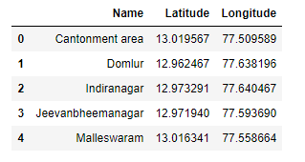
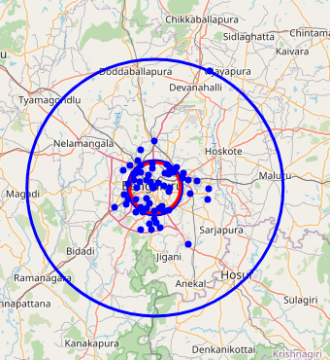
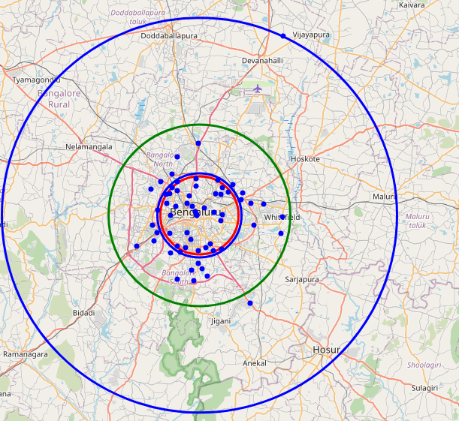
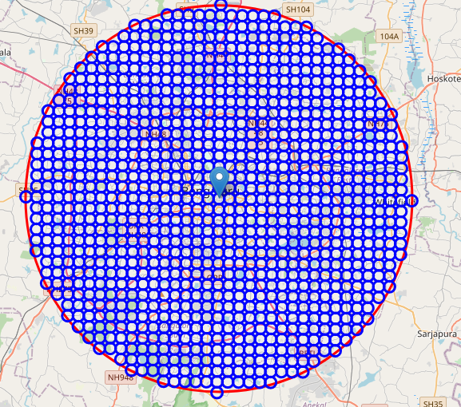
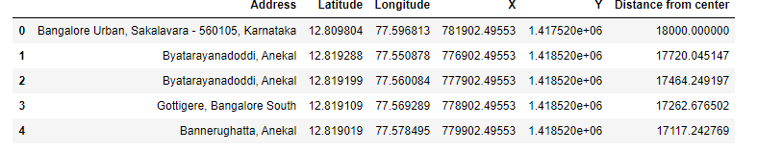
Stages of Data Acquisition
Get Spatial Coordinates of Each Location
Plot Each Location and do comparative study to find Effective Radius
The effective Radius shown as Green Circle Denotes area of Analysis
Entire Area of Bangalore is Divided into Circular Cells of 500 M Radius
For each Cell the Spatial Coordinates and Cartesian Coordinates

Slide 5
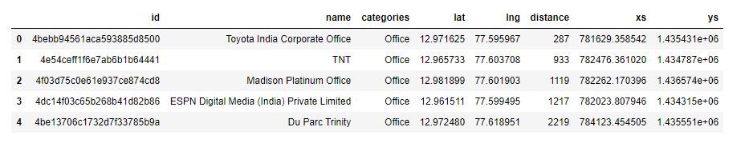
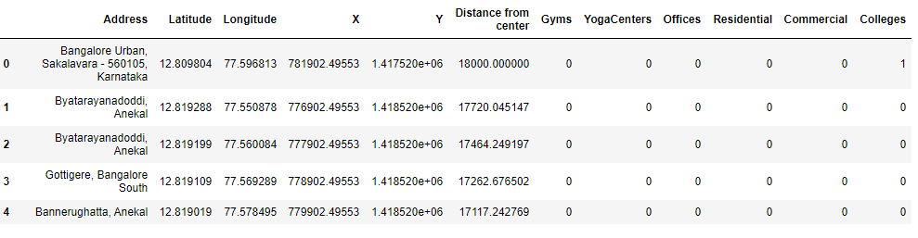
Data Refinement
Above Data is Combined to Arrive at following final data for Exploration

Slide 6
Methodology
Analyse the extracted data to determine Primary locations of interest.
Do an exploratory analysis to determine Secondary Locations of Interest .
Using Kmeans Clustering Algorithm identify Primary and Secondary Clusters of interest
Use Reverse Geocoding to determine the addresses of the the clusters as the final result

Slide 7
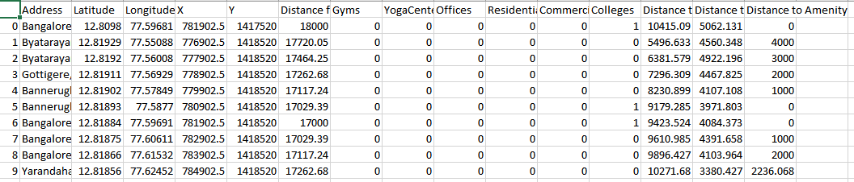
Further Analysis of Data Collected in Previous Stage
We compute for each location distance to nearest Gym, Yoga Centre and Amenities

Slide 8
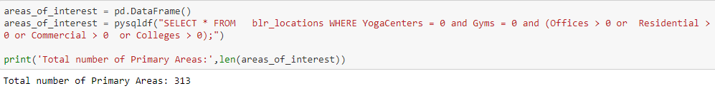
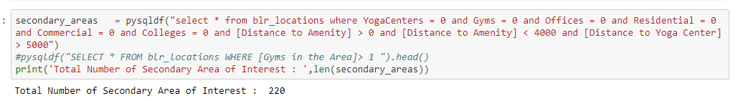
Selecting Required Data
Using Panda Sql we derive our Desired Primary and Secondary Locations

Slide 9
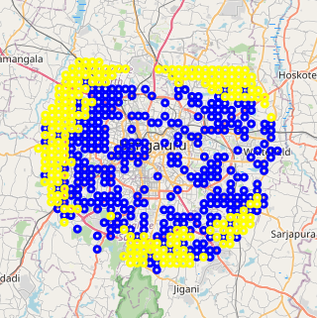
Plotting on Map to Show Areas of Interest
Areas marked in Blue are Primary Locations
Areas marked in Yellow are the Secondary Locations

Slide 10
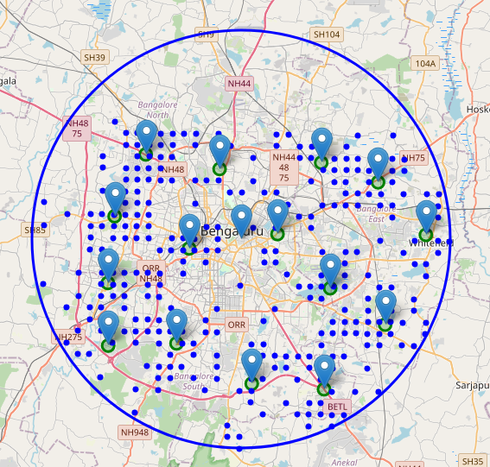
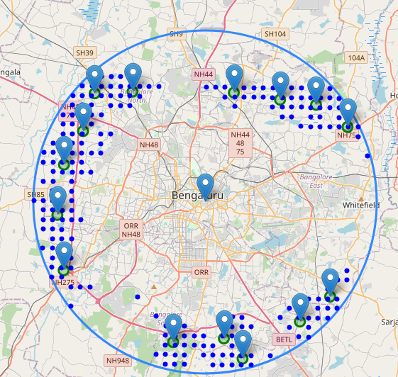
Clustering the Locations
Using K-means Clustering Algorithm we create 15 clusters of Primary and Secondary Locations
Cluster of Primary Locations
Cluster of Secondary Locations

Slide 11
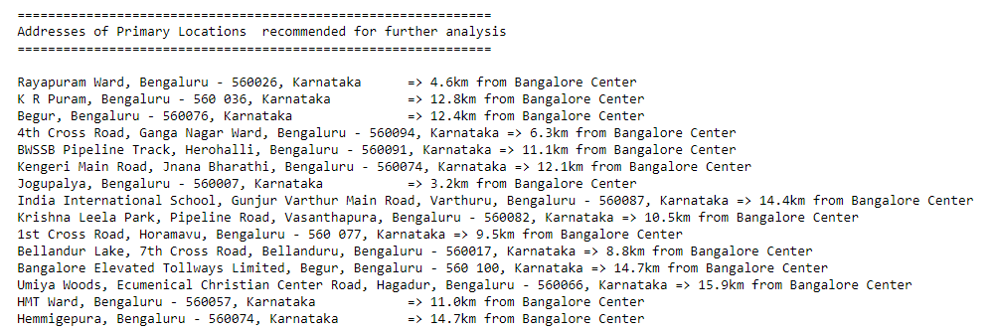
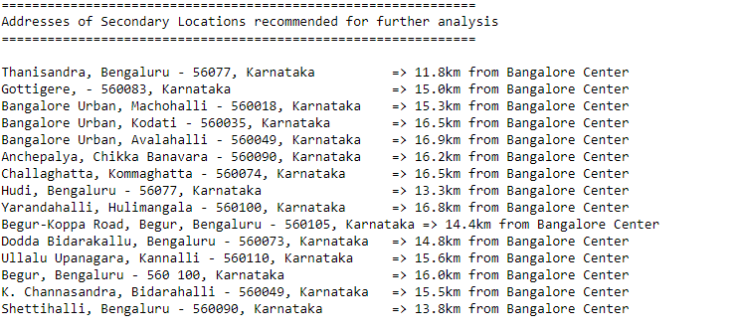
Final Result of Probable Locations

Slide 12
Conclusion
The addresses are mere Starting Points for further exploration by stake holders
Additional information like Real Estate rates, Population demographics of the area would aid in further refinement.

